Slide 1

School of Mechanical Engineering
Course Code: BME01T1001 Course Name: Engineering Graphics and Introduction to Digital Fabrication
Unit 1
Projection of Planes
Faculty Name: Mr. Brahma Nand Agrawal Program Name: B.Tech First Year

Slide 2
Prerequisite/Recapitulations
Drawing, Sketching
First angle & third angle projection
Basics of engineering graphics
Projection of Point
Projection of Straight Lines

Slide 3
Learning objectives
To acquire knowledge about:
Different cases of Projection of planes

Slide 4
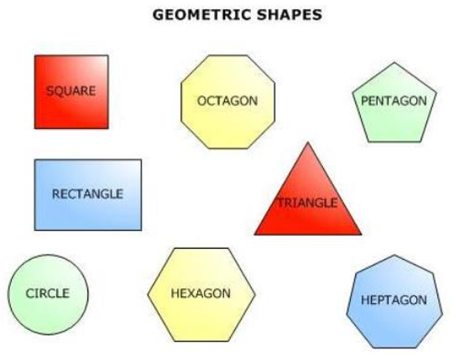
Types of Planes
•Two dimensional objects are called planes.
•They have length, breadth and negligible thickness

Slide 5
Types of Planes contd.
There are two types of Planes:
Perpendicular planes: Divided into sub-types:
(i) Perpendicular to both the reference planes.
(ii) Perpendicular to one plane and parallel to the other.
(iii) Perpendicular to one plane and incline to the other.
2. Oblique planes which have their surface inclined to both the reference planes.

Slide 6
Projection of Planes
In this topic various plane figures are the objects.
What is usually asked in the problem:
To draw their projections, means F.V, T.V & S.V
What will be given in the problem:
Description of the plane figure.
2. It’s position with HP and VP.
In which manner it’s position with H.P. & V.P. will be described:
1. Inclination of it’s SURFACE with one of the reference planes will be given.
2. Inclination of one of it’s EDGES with other reference plane will be given .

Slide 7
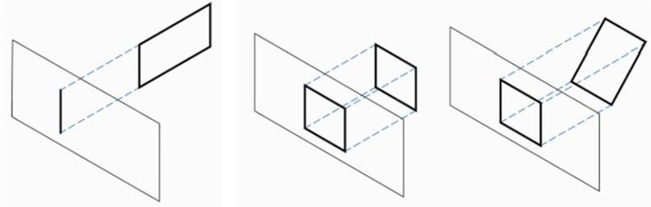
Orientation of Planes
Perpendicular (Edge view)
Parallel (True shape and size)
Inclines (Foreshortened shape)
Perpendicular b) Parallel c) Inclines

Slide 8
Different problems for Projection of Planes
Surface perpendicular to both HP and VP
Surface parallel to HP and perpendicular to VP
Surface inclined to HP and perpendicular to VP

Slide 9
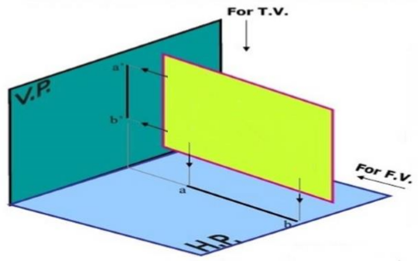
PROJECTION OF DIFFERENT TYPES OF PLANES
Plane PERPENDICULAR to both the reference planes:
Front View (F.V.) and Top View (T.V.) are both lines

Slide 10
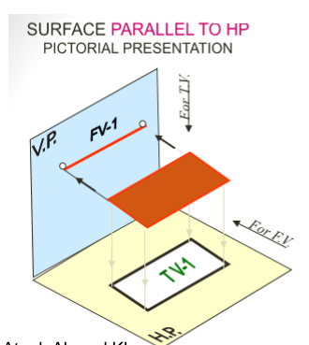
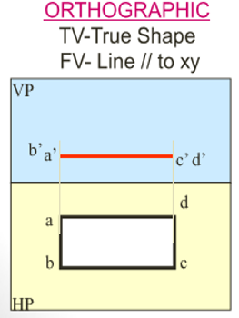
PROJECTION OF DIFFERENT TYPES OF PLANES
B. Plane PERPENDICULAR to one plane and PARALLEL to other reference planes:

Slide 11
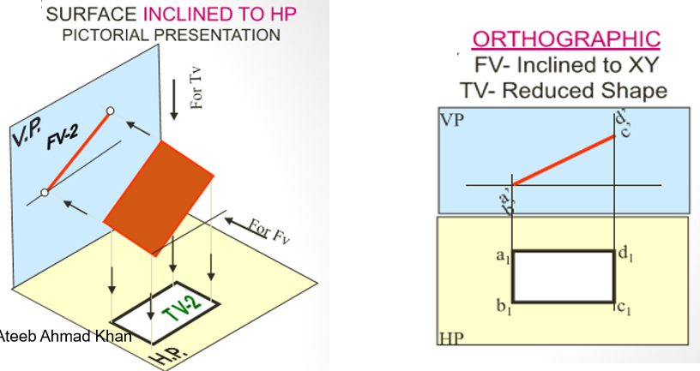
PROJECTION OF DIFFERENT TYPES OF PLANES
C. Plane PERPENDICULAR to V.P. and Inclined to H.P.:

Slide 12
The projection of INCLINED PLANE is drawn in two stages
In the initial stage, the plane is assumed to be parallel to that reference plane to which it has been made inclined. It is then tilted to required inclination in the second stage.
Plane, inclined to H.P. and perpendicular to V.P.:
It is assumed to be parallel to H.P. and perpendicular to V.P.
T.V. will show the true shape and F.V. will be a line parallel to XY
F.V. is then tilted to the required inclination with XY
T.V. is then obtained by moving the corners along their respective paths (parallel to XY) and perpendicular to XY from the view which is a line.
T.V. will show a reduced shape and F.V. will be a line tilted to XY

Slide 13
The projection of INCLINED PLANE is drawn in two stages Contd.
b. Plane, inclined to V.P. and perpendicular to H.P.:
It is assumed to be parallel to V.P. and perpendicular to H.P.
F.V. will show the true shape and T.V. will be a line parallel to XY
T.V. is then tilted to the required inclination with XY
F.V. is then obtained by moving the corners along their respective paths (parallel to XY) and perpendicular to XY from the view which is a line (T.V.).
F.V. will show a reduced shape and T.V. will be a line tilted to XY

Slide 14
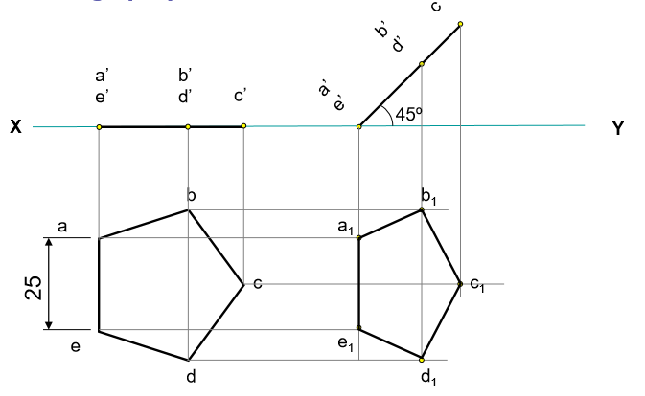
PROJECTION OF DIFFERENT TYPES OF PLANES
Example: A regular pentagon of 25mm side has one side on the ground. Its plane is inclined at 45º to the HP and perpendicular to the VP. Draw its projections
Hint: As the plane is inclined to HP, it should be kept parallel to HP with one edge perpendicular to VP

Slide 15
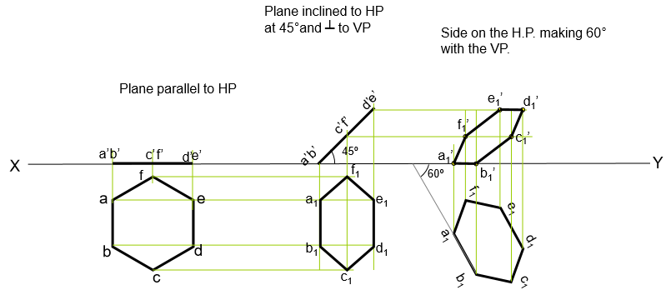
PROJECTION OF DIFFERENT TYPES OF PLANES
PROBLEM 2: Draw the projections of a regular hexagon of 25mm sides, having one of its side in the H.P. and inclined at 60 to the V.P. and its surface making an angle of 45º with the H.P.

Slide 16
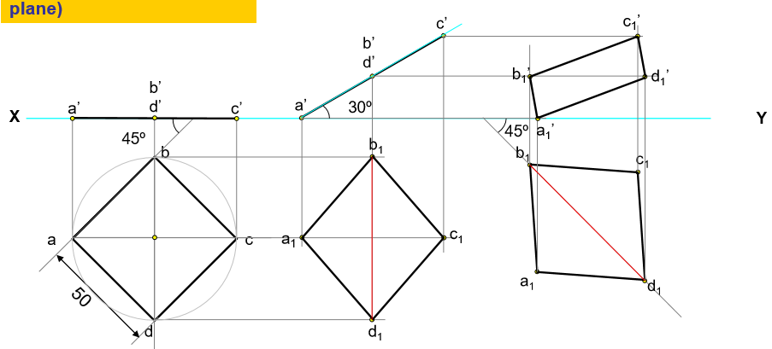
PROJECTION OF DIFFERENT TYPES OF PLANES
PROBLEM 3: A square ABCD of 50 mm side has its corner A in the H.P., its diagonal AC inclined at 30º to the H.P. and the diagonal BD inclined at 45º to the V.P. and parallel to the H.P. Draw its projections.
Keep AC parallel to the H.P. & BD perpendicular to V.P. (considering inclination of AC as inclination of the plane)
Incline AC at 30º to the H.P. i.e. incline the edge view (FV) at 30º to the HP
Incline BD at 45º to the V.P.

Slide 17
Summary
Learners are able to draw:
Surface perpendicular to both HP and VP
Surface parallel to HP and perpendicular to VP
Surface inclined to HP and perpendicular to VP
Surface inclined to VP and perpendicular to HP

Slide 18
Questions
Problem 1: A 30 – 60 degree set square of longest side 100 mm long, is in VP and 30 degree inclined to HP while it’s surface is 45 deg. inclined to VP. Draw it’s projections.
Problem 2: A 30 – 60 degree set square of longest side 100 mm long is in VP and it’s surface 45 deg. inclined to VP. One end of longest side is 10 mm and other end is 35 mm above HP. Draw it’s projections.
Problem 3: A regular pentagon of 30 mm sides is resting on HP on one of it’s sides with it’s surface 45 deg. inclined to HP. Draw it’s projections when the side in HP makes 30 deg. angle with VP.
Problem 4: A regular pentagon of 30 mm sides is resting on HP on one of it’s sides while it’s opposite vertex (corner) is 30 mm above HP. Draw projections when side in HP is 30 deg. inclined to VP.

Slide 19
References
Engineering Drawing by N. D. Bhatt and V. M. Panchal
Engineering Graphics by K. C. John
NPTEL

Slide 20
Email: brahma.agrawal@galgotiasuniversity.edu.in
Thank You

